Slide 1



EMBEDDED SYSTEMS
ELECTRONICS AND COMMUNICATION ENGINEERING
By
SHRUTHI MEENAKSHI M
22ECEB24
III YEAR ECE-B

Slide 2
CONCEPT
Definition
Types
History
Working
Structure
Characteristics
Examples
Trends

Slide 3
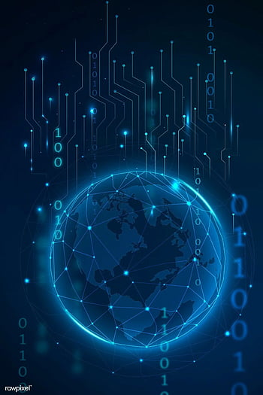
INTRODUCTON
DEFINITION
An Embedded system is a combination of computer hardware and software designed for a specific function.
Embedded systems typically contain a microprocessor or a microcontroller based system, memory and input/output (I/O) devices, all of which share a dedicated function within a larger system. While embedded systems are computing systems, they can range from having no user interface (UI).

Slide 4
TYPES OF EMBEDDED SYSTEM
Based on Functional requirement:
Mobile embedded systems
Networked embedded systems
Standalone embedded systems
Real-time embedded systems
Based on Performance requirements:
Small-scale embedded systems
Medium-scale embedded systems
Sophisticated-scale embedded systems

Slide 5
HISTORY
Charles Stark Draper developed an integrated circuit in 1961 the digital system installed on the Apollo Command Module and Lunar Module. The first computer to use integrated circuits, it helped astronauts collect real-time flight data.
In 1987, the first embedded OS
Followed by Microsoft's Windows Embedded CE in 1996.
By the late 1990s, the first embedded Linux products began to appear. Today, Linux is used in almost all embedded devices.

Slide 6
How does an Embedded System Work?
They're low-cost, low-power consuming, small computers that are embedded in other mechanical or electrical systems. Generally, they comprise a processor, power supply, and memory and communication ports. Embedded systems use the communication ports to transmit data between the processor and peripheral devices
The term system-on-a-chip (SoC) typically include multiple processors and interfaces on one chip. They're often used for high-volume embedded systems. Some examples of SoC types are the application-specific integrated circuit (ASIC) and the field-programmable gate array (FPGA).
Often, embedded systems are used in real-time operating environments and use a real-time operating system (RTOS) to communicate with the hardware.

Slide 7
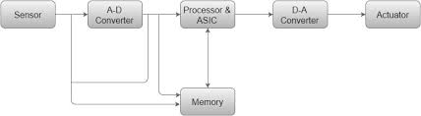
Structure of Embedded Systems
Hardware
Software and Firmware
RTOSes.
In terms of hardware,
Sensors
Analog-to-digital converters & Digital-to-analog converters
Processors
Actuators

Slide 8
CHARACTERISTICS OF EMBEDDED SYSTEM
Sensing and real-time computing in internet of things (IoT) devices.
ASIC and FPGA SoCs.
To perform their function under a time constraint to keep the larger system functioning properly
They can be either microprocessor-based or microcontroller-based

Slide 9
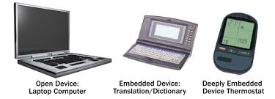
EXAMPLES OF EMBEDDED SYSTEM
Automobiles
Mobile phones
Industrial machines
Medical equipment
Fitness trackers

Slide 10
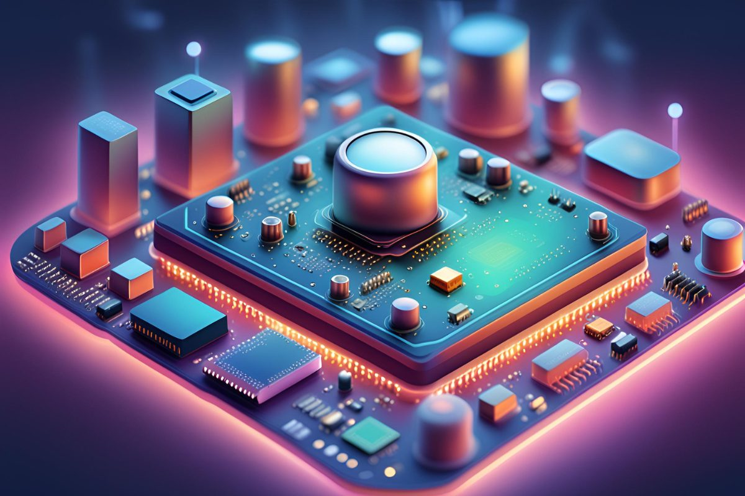
Embedded system trends
AI and ML
Edge computing
Security
Increased connectivity
Quantum computing

Slide 11

THANK YOU

